Slide 1
AWS Signup

Slide 2
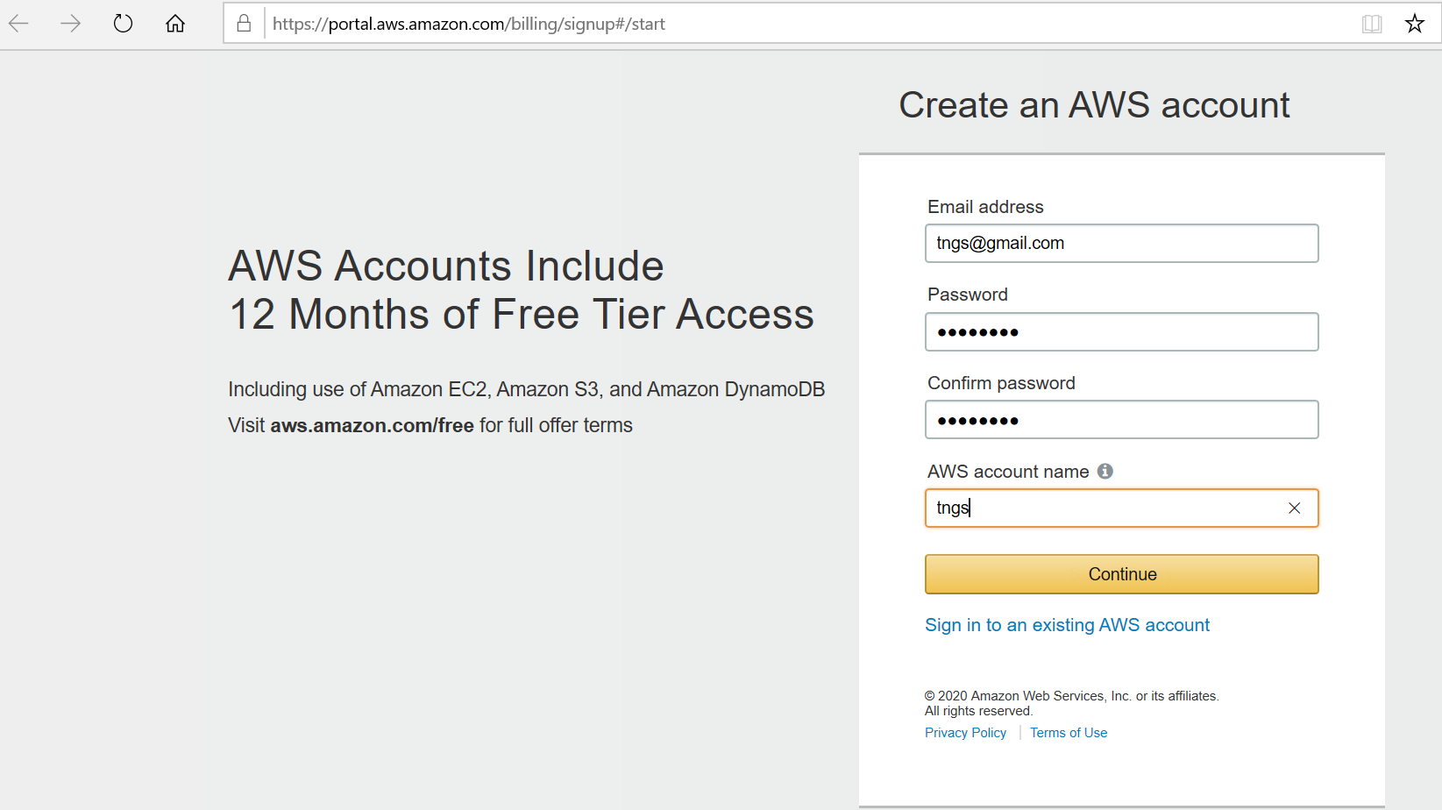
AWS signup step by step process
Open below URL to open AWS signup or login landing page.
https://portal.aws.amazon.com/billing/signup#/start
Enter your email id and specify a password, then enter a name for your account.
Click on Continue.
You will be displayed with the below screen.

Slide 3
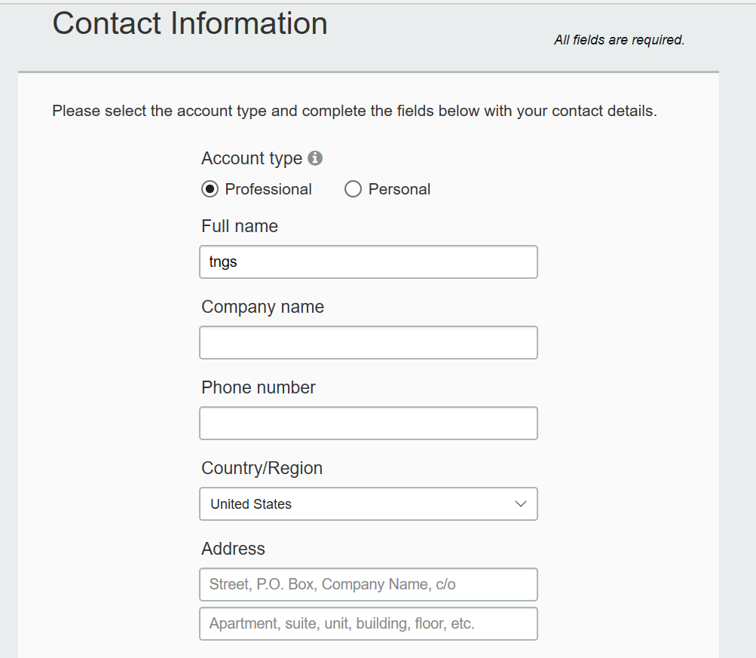

Slide 4
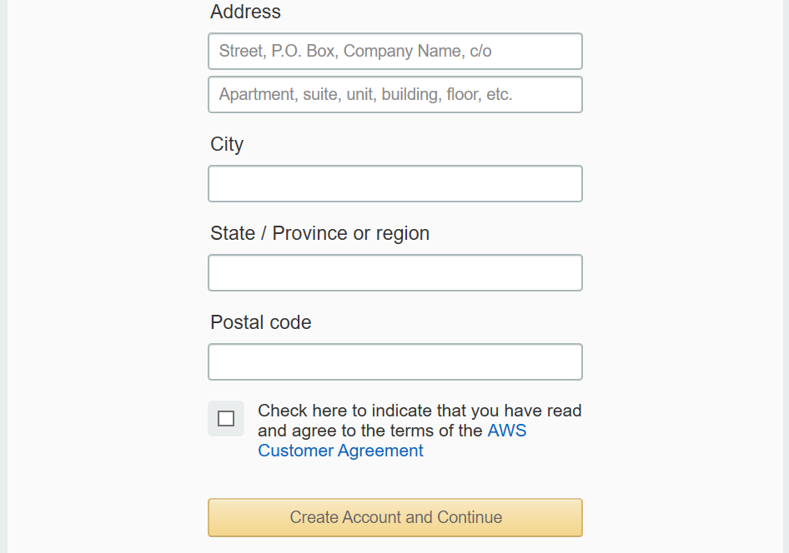
Select the account type as personnel for personnel usage or select Professional for corporate usage.
Then specify the phone number, and address details. Select the check box to agree the terms and click on Create Account and Continue.

Slide 5
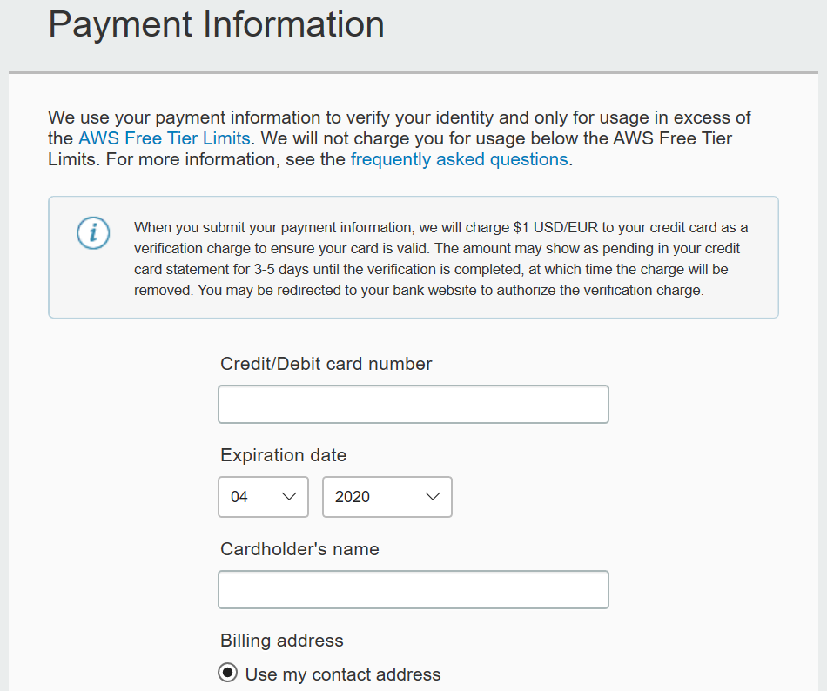
Then provide your credit/debit card details, specify billing address and if you want to provide your PAN info select Yes and provide or choose No, finally click on Secure Submit.

Slide 6
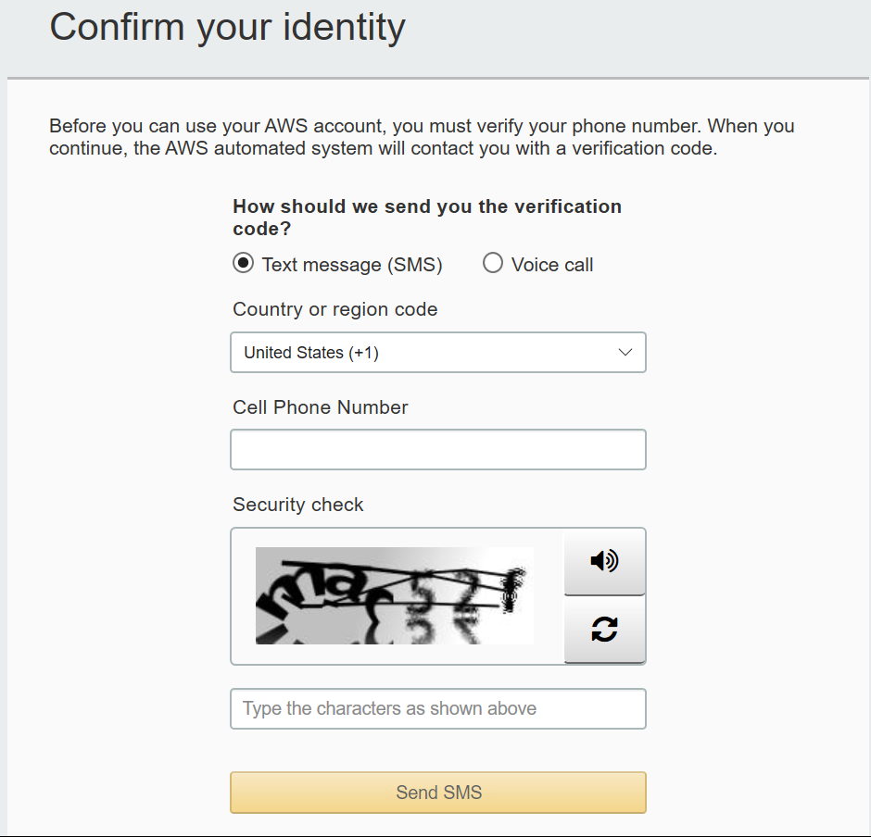
Next, provide you phone information for phone verification, note that you will get IVR call on the specified number make a note of that. Then click on call Me Now when you are ready.

Slide 7
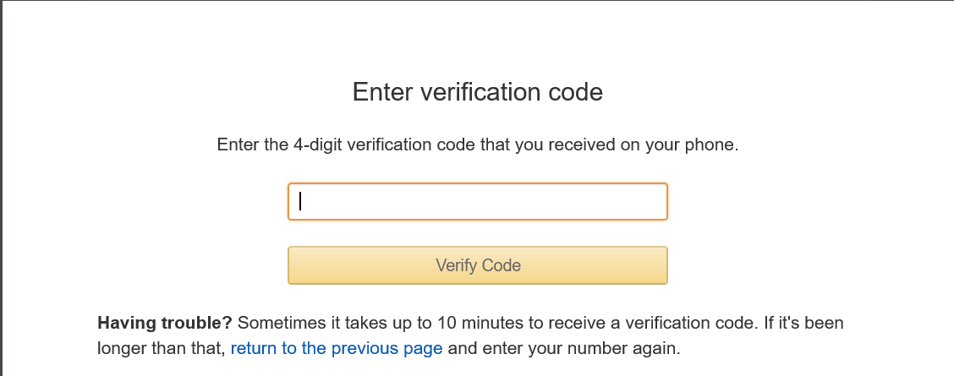
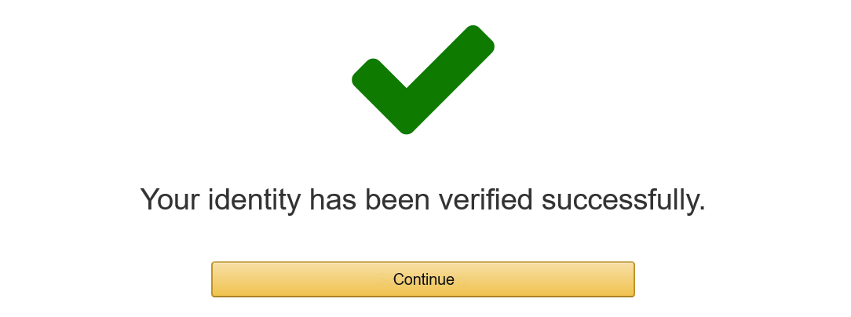
Once completed successfully, you will get a confirmation like this.

Slide 8
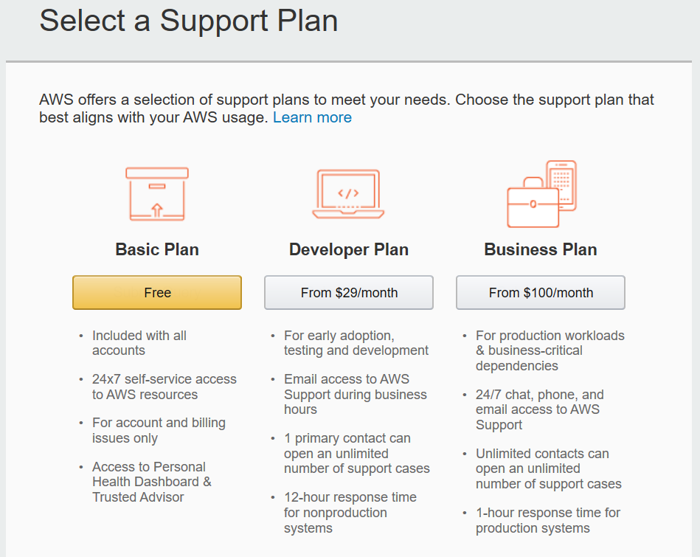
Next, select the support plan as Basic Plan which is free.
You can find the more information on the below link regarding the support plans and its features
https://aws.amazon.com/premiumsupport/plans/

Slide 9
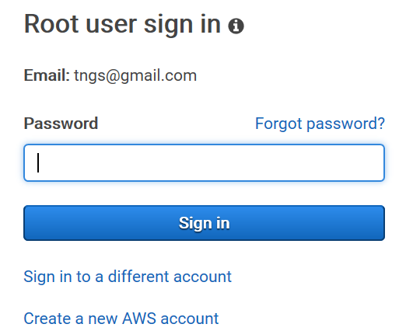
Provide your email id which you have used to sign up to AWS, then click on Next.
Next provide your password and click on sign in to sing in to AWS console.

Slide 10
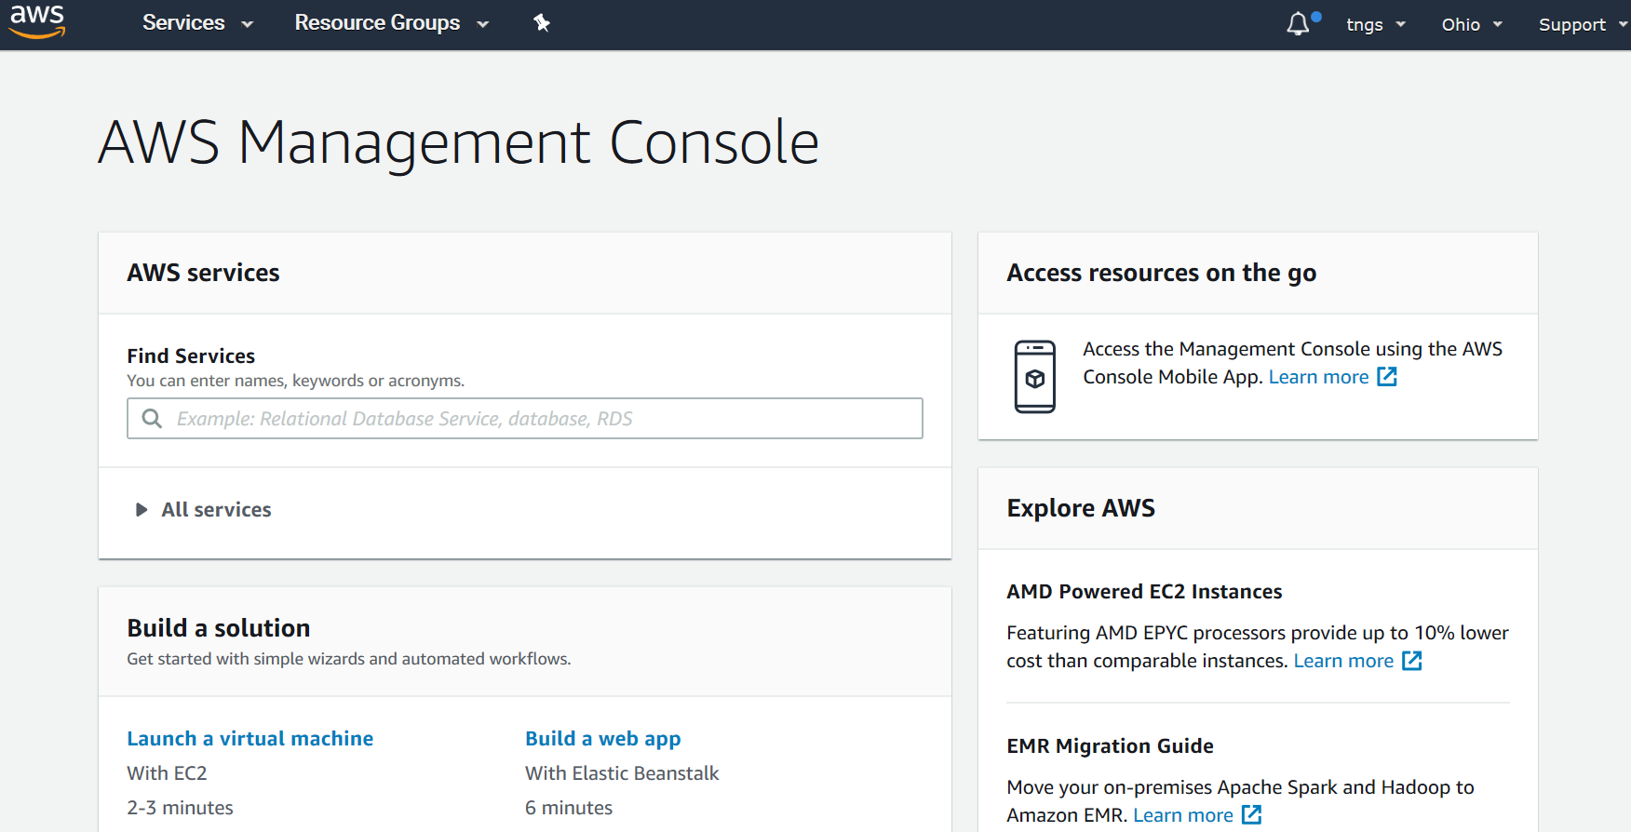
Once signed in you will get in to AWS console look like above.

